Slide 1


Social Buzz
Data Analysis
Notes:
Hello and welcome, my name is Dennis and today I will be presenting to you the results of Social Buzz Data Analytics task.

Slide 2


Today's agenda
Project recap
Problem
The Analytics team
Process
Insights
Summary
Notes:
Let's delve into the project's journey. We'll start with a quick recap, then dissect the problem we aimed to solve. We'll shine a light on the incredible work of the Analytics Team and the process they employed. Next, we'll explore the insights gleaned from the project. Finally, we'll wrap it up with a concise summary of the key takeaways

Slide 3


Social Buzz is a fast growing social media unicorn that needs to scale rapidly. Accenture has begun a three – month initial engagement to:
Audit their big data practice.
Provide Recommendations for a Successful IPO.
Analysis to find Social Buzz’s top 5 most popular categories of content
Project Recap

Slide 4


Problem
The client has reached a massive scale within recent years and does not have the resources internally to handle it.
Audit of big data practice, recommendations for IPO, analysis of popular content
Analysis of sample data sets with visualizations to understand the popularity of different content categories

Slide 5



The Analytics team
Notes:
Talking about my experience, we have a large data analytics practice at Accenture. For this project, we had a team of 3 people primarily focusing on this task. Andrew Fleming is our Chief Technical Architect and his expertise really helped to guide the team to produce high quality analysis.
Marcus Rompton, a senior data expert has worked with the worlds biggest clients on solving their data problems and was heavily involved in the data engineering side of this project.
And finally myself, Dennis, who was solely responsible for taking leadership guidance and delivering high quality insights from the raw datasets and turning these into business decisions.

Slide 6

Process
1
Data Understanding
2
Data Cleaning
3
Data Modelling
4
Data Analysis
5
Uncover Insights
Notes:
So, how are we going to tackle this problem?
We will approach it in 5 steps:
1. Data understanding - the key to success on any data project is to understand the data in detail. So we took the time to understand the data model and domain of your business.
2. Data extraction - after understanding your business, we then architected what an ideal dataset should look like for this problem and extracted it from the relevant data sources.
3. After extracting the raw data, we needed to process and model this data into a dataset that can precisely answer the business questions and produce analytics.
4. With our new dataset, we used our analytical expertise to uncover insights from this dataset and to produce visualizations to describe the insights.
5. And finally we used these insights to unlock business decisions and to make recommendations on next steps.

Slide 7


Insights
1897
Reactions to ‘Animal’ Posts
MAY
Month with Most posts
16
Unique Categories
Notes:
From your data we found that you had a total of 16 unique categories of posts across your sample dataset. This includes things such as Food, Culture and Sport.
As well as this, there was 1897 Reactions to ‘Animal’ Posts alone! People obviously really like animals!
And also the most common month for users to post within was MAY, this is interesting to know that people are most active during this month!
But now, onto the main question... which is... what were the top 5 most popular categories of posts?

Slide 8
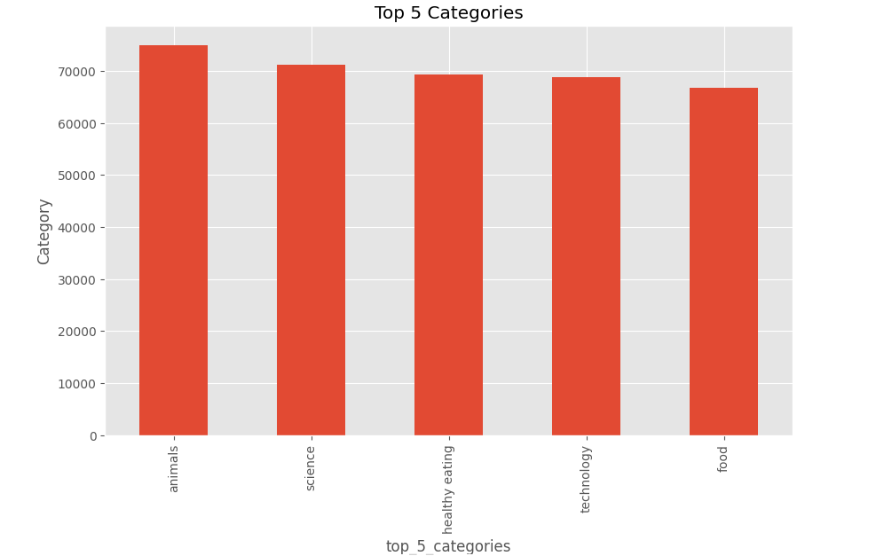

Slide 9
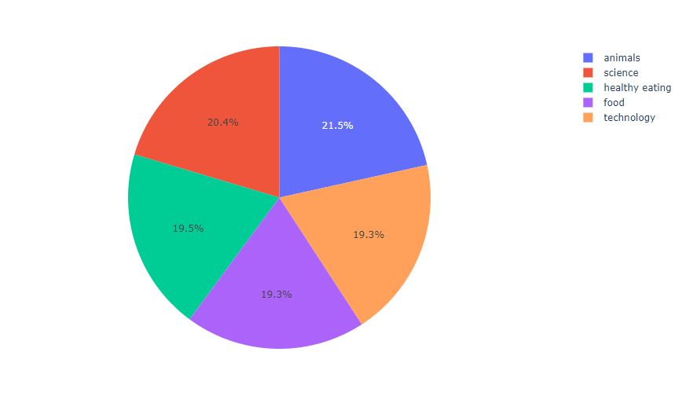
Popularity percentage share from the top 5 categories
Notes:
Additionally, you can see from this chart the % split of popularity between the top 5 categories. There is not much difference between each of them, animals only outperforms technology by 2.2% within the top 5.
However the difference between the 3rd most popular, cooking, and the 4th most popular, healthy eating, is much larger at 0.2%
This tells me that the categories sorted by popularity is weighted towards categories at the top. This means that it exhibits a "greedy" effect, the most popular categories get more popular whilst as you drop down the popularity rankings, you may see that they fall away drastically.

Slide 10


ANALYSIS
Animals and science are two most popular categories of content, showing that people enjoy ‘real-life’ and ‘factual’ content the most.
INSIGHT
Food is a common theme with the top 5 Categories with “Science” ranking the highest. This may give an indication to the audience within your user base. You could use the insight to create a campaign and work with healthy eating brands to boots user engagement.
NEXT STEPS
This ad-hoc analysis is insightful, but it’s time to take this analysis into large scale production for real-time understanding of your business. We can show you how to do this.
Summary
Notes:
So to summarize:
We tackled this task and found the top 5 most popular categories as asked, but we also went one step further.
- We found that animals and science are the two most popular categories, suggesting that users like "real-life" content
- We also found that healthy eating was the third most popular, perhaps due to the tournament coming up. This presents a massive opportunity for Social Buzz to ride on this global event, as all eyes will be on it as well as the players.
- As much as this analysis was insightful, we are ready to take it to the next stage and we have the expertise within Accenture to help you realize these kinds of insights in production across your organization and in real time. We would love to help you with this.

Slide 11

Thank you!
ANY QUESTIONS?
Notes:
Thank you very much for listening, please feel free to ask any questions that you may have!

